Slide 1

Excellence in Business Communication - Chapter 3
ENL 320

Slide 2
Excellence in Business Communication
Chapter 3
Communication Challenges in a Diverse, Global Marketplace

Slide 3
Learning Objectives (1 of 2)
Discuss the opportunities and challenges of intercultural communication.
Define culture, explain how culture is learned, and define ethnocentrism and stereotyping.
Explain the importance of recognizing cultural variations, and list eight categories of cultural differences.

Slide 4
Learning Objectives (2 of 2)
List four general guidelines for adapting to any business culture.
Identify seven steps you can take to improve your intercultural communication skills.

Slide 5
Communicating in a Diverse World
(LO 1) Discuss the opportunities and challenges of intercultural communication.
Notes:
Throughout your career, you will interact with people who differ in race, age, gender, sexual orientation, national and regional attitudes and beliefs, family structure, religion, native language, physical and cognitive abilities, life experience, and educational background. Although the concept of diversity is often framed in terms of ethnic background, a broader and more useful definition includes all the characteristics and experiences that define each of us as individuals.
This section looks at the advantages and challenges of a diverse workforce from a communication perspective, key differences among cultures, and advice for communicating across cultures.

Slide 6
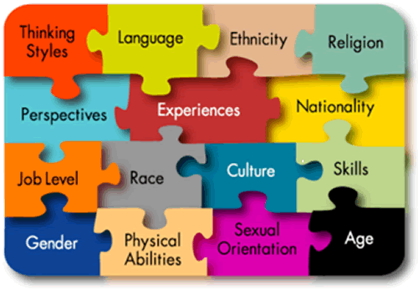

Slide 7
Advantages of a Diverse Workforce
•Obtaining More Views and Ideas
•Understanding Diverse Markets
•Accessing a Wider Pool of Talent
Notes:
A diverse workforce offers a broader spectrum of viewpoints and ideas, helps companies understand and identify with diverse markets, and enables companies to benefit from a wider range of employee talents.

Slide 8
Challenges of Intercultural Communication
•Language Barriers
•Misunderstanding of Words and Nonverbal Cues
•Time and Space Preferences
Notes:
Today’s increasingly diverse workforce encompasses a wide range of skills, traditions, backgrounds, experiences, outlooks, and attitudes toward work—all of which can affect communication in the workplace. Supervisors face the challenge of connecting with these diverse employees, motivating them, and fostering cooperation and harmony among them. Teams face the challenge of working together closely, and companies are challenged to coexist peacefully with business partners and with the community as a whole.

Slide 9

Language barrier

Slide 10
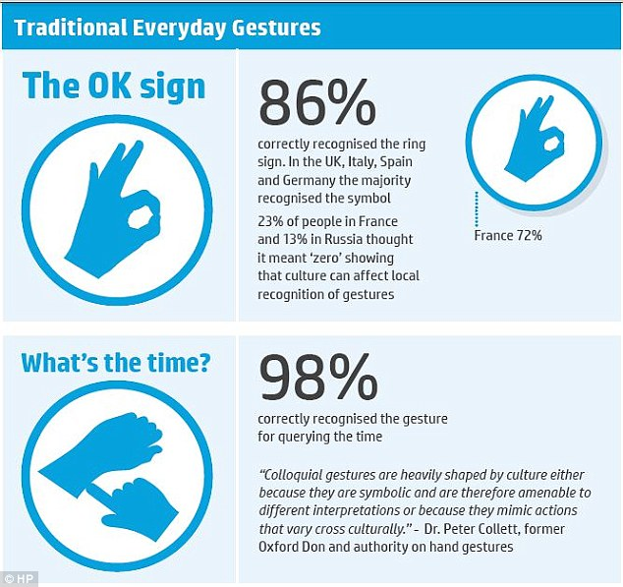
Words and non-verbal cues

Slide 11

Misunderstanding words

Slide 12
Developing Cultural Competency
(LO 2) Define culture, explain how culture is learned, and define ethnocentrism and stereotyping.

Slide 13
Culture
Culture
  Shared system of symbols, beliefs, attitudes, values, expectations, and behavior norms
Notes:
Culture is a shared system of symbols, beliefs, attitudes, values, expectations, and norms for behavior. Your cultural background influences the way you prioritize what is important in life, helps define your attitude toward what is appropriate in a situation, and establishes rules of behavior.
People learn culture directly and indirectly from other members of their group. As you grow up in a culture, you are taught by the group’s members who you are and how best to function in that culture. Sometimes you are explicitly told which behaviors are acceptable; at other times you learn by observing which values work best in a particular group. In these ways, culture is passed on from person to person and from generation to generation.

Slide 14
  Learning Culture
  Directly - > Through Instruction
  Indirectly - > Observing Others

Slide 15
Discuss Kuwaiti culture
What are the shared attitudes, values, expectations, and behavior norms?

Slide 16
Challenges of a Diverse Workforce
Understanding the
Effects of Culture
Developing Cultural
Competency
Notes:
For all their benefits, diverse workforces and markets present communication challenges, and understanding the effect of culture on communication is essential: culture influences the way people perceive the world and respond to others, which affects the way they communicate as both senders and receivers. These influences operate on such a fundamental level that people often don’t recognize the influence of culture on their beliefs and behaviors. This subconscious effect of culture can create friction because it leads people to assume that everybody thinks and feels the way they do. However, differences between cultures can be profound.
Developing cultural competency can keep cultural differences from impeding communication. Such competency involves an appreciation for the cultural differences that affect communication, and the ability to adjust one’s style when sending and receiving messages across cultural boundaries.

Slide 17
Recognizing Variations in a Diverse World
(LO 3) Explain the importance of recognizing cultural variations, and list eight categories of cultural differences.

Slide 18
Key Aspects of Cultural Diversity
Cultural Context
Age Differences
Legal and Ethical
Gender Differences
Social Customs
Religious Differences
Nonverbal Signals
Ability Differences
Notes:
You don’t need to become an expert in the details of every culture in which you do business, but you do need to attain a basic level of cultural proficiency to ensure successful communication. You can start by recognizing and accommodating the following differences: cultural context, legal and ethical views, social customs, nonverbal signals, age, gender, religion, and abilities. All of these differences are covered in this section.
Note: This discussion of cultural diversity is an overview only, with some generalizations that won’t be accurate in every situation. Always consider the unique circumstances of each encounter when making communication decisions.

Slide 19
Cultural Context
More
Less
Low-Context Culture
Message Content
Circumstances
High-Context Culture
Less
More
Notes:
Every attempt at communication occurs within a cultural context—the mixture of traditions, expectations, and unwritten social rules that help convey meaning between members of the same culture. Cultures vary widely in the role that context plays in communication.
In a high-context culture, people rely less on the explicit content of the message and more on the context of nonverbal actions and environmental setting to convey meaning. In such cultures, as individuals grow up, they learn how to recognize situational cues (such as gestures and tone of voice) and how to respond as expected. Also, in a high-context culture, the primary role of communication is often building relationships, not exchanging information.
In a low-context culture, people rely more on the explicit content of the message and less on circumstances and cues to convey meaning. In other words, more of the conveyed meaning is encoded into the actual message itself.
The different expectations of low- and high-context cultures can create friction and misunderstanding when people try to communicate across cultural boundaries.

Slide 20
Legal and Ethical Differences
Seek Mutual
Ground
Withhold Judgment
Send Honest
Messages
Respect Cultural
Differences
Notes:
Cultural context also influences legal and ethical behavior. For example, because low-context cultures value the written word, written agreements are binding. High-context cultures put less emphasis on the written word and consider personal pledges more important than contracts. They also tend to view law with flexibility; on the other hand, low-context cultures value the letter of the law.
Ethical principles are based to a large extent on cultural values, so trying to make ethical choices across cultures can be complicated. When communicating across cultures, keep your messages ethical by applying four basic principles:
Actively seek mutual ground.
Send and receive messages without judgment.
Send messages that are honest.
Show respect for cultural differences.

Slide 21
Social Customs
Etiquette and Manners
Attitudes toward Time
Informal Rules
Individualism vs. Collectivism
Formal Rules
Attitudes toward Status or Wealth
Respect for Authority
Notes:
Social behavior is guided by numerous rules, some of them formal and specifically articulated (table manners are a good example) and others more informal and learned over time (such as the comfortable standing distance between two speakers in an office). The combination of formal and informal rules influences the overall behavior of everyone in a society in such areas as manners, attitudes toward time, individual versus community values, attitudes toward status and wealth, and respect for authority.
Understanding the nuances of social customs takes time and effort, but most businesspeople are happy to explain the habits and expectations of their culture. Plus, they will view your curiosity as a sign of respect.

Slide 22

High or low context

Slide 23
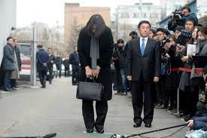
Attitude toward authority

Slide 24


Slide 25

Attitude toward time

Slide 26

Attitude toward status and wealth

Slide 27
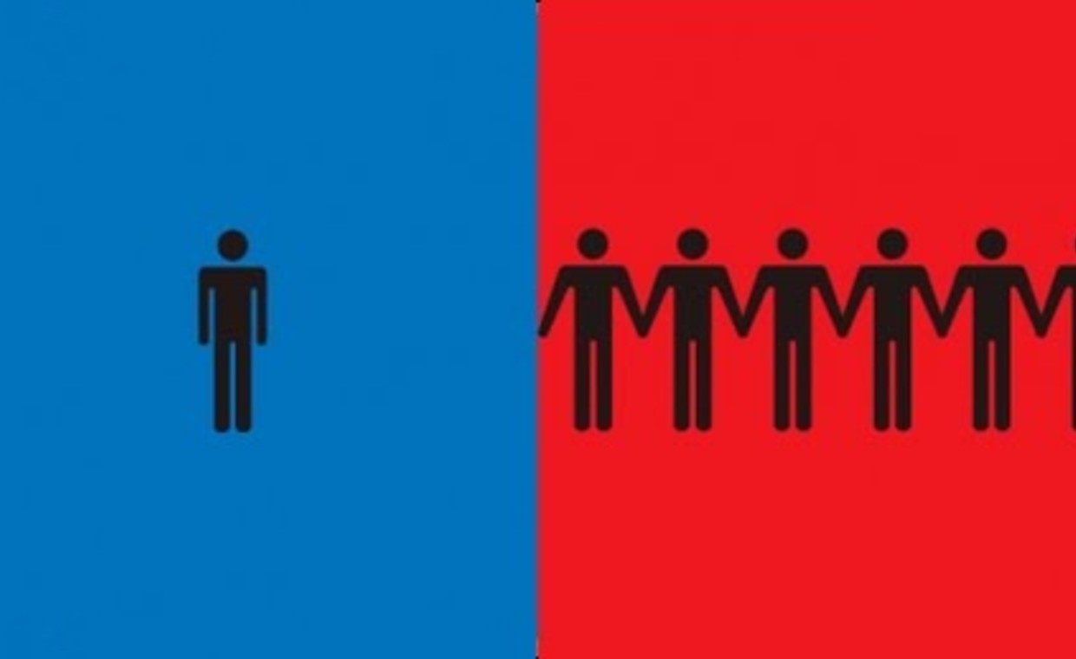
Individualism vs. collectivism

Slide 28
Nonverbal Communication
Communication Process
Decoding
Messages
Interpreting
Messages
Cultural Context
Notes:
Nonverbal communication is a vital part of the communication process. Everything from facial expressions to style of dress can influence the way receivers decode messages, and the interpretation of nonverbal signals can vary widely from culture to culture. Don’t assume that the gestures you grew up with will translate to another culture; doing so could lead to embarrassing mistakes. (Refer to Chapter 2 for more about nonverbal communication.)

Slide 29
Age Differences
Cultures that Value Youth
Cultures that Value Seniority
Cultures with Multiple Generations
Notes:
In some cultures, youth is associated with strength, energy, possibilities, and freedom. Age is often associated with declining power and a loss of respect and authority. In contrast, in cultures that value age and seniority, longevity earns respect and increasing power and freedom.
Each generation can bring particular strengths to the workplace. For instance, older workers can offer broader experience, the benefits of important business relationships nurtured over many years, and high degrees of “practical intelligence,” such as the ability to solve complex, poorly-defined problems. However, getting the benefits of having multiple generations in a workplace can require some accommodation on everyone’s part because of differing habits and perspectives.

Slide 30
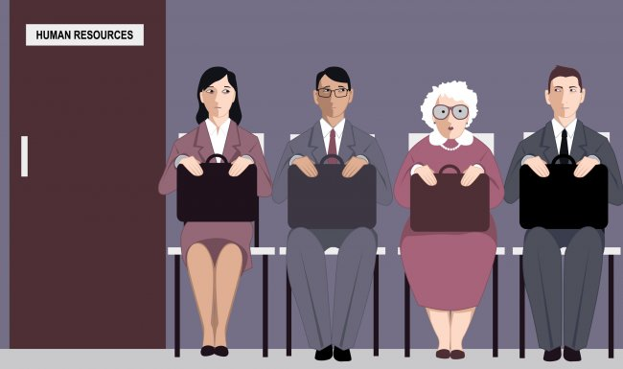
Ageism

Slide 31
Gender Differences
Perception of Men and Women
Percentage of Management Roles
Different Communication Styles
Notes:
Gender influences workplace communication in several important ways. First, the perception of men and women in business varies from culture to culture, and gender bias can range from overt discrimination to subtle and even unconscious beliefs.
Second, although the ratio of men and women in entry-level professional positions is roughly equal, the percentage of management roles held by men increases steadily the further one looks up the corporate ladder. This imbalance can significantly affect communication in such areas as mentoring, which is a vital development opportunity for lower and middle managers who want to move into senior positions.
Third, evidence suggests that men and women tend to have somewhat different communication styles. Broadly speaking, men emphasize content and outcomes in their communication efforts, whereas women place a higher premium on relationship maintenance. Changing these perceptions could go a long way toward improving communication and equity in the workplace.

Slide 32

Sexism

Slide 33
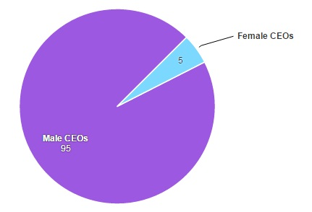
The Financial Times Stock Exchange 100 Index

Slide 34
Religious Differences
Personal
Beliefs
Workplace
Issues
Notes:
As one of the most personal and influential aspects of life, religion brings potential for controversy in a work setting—as evidenced by a significant rise in the number of religious discrimination lawsuits. Some employees feel they should be able to express their beliefs in the workplace, but companies try to avoid situations in which openly-expressed religious differences cause friction between employees or distract employees from their responsibilities. As more companies work to establish inclusive workplaces, you can expect to see this issue being discussed at many companies in the coming years.

Slide 35
Ability Differences
Respect for Individuals
Sensitivity to Differences
Use of Assistive Technologies
Notes:
People whose hearing, vision, cognitive ability, or physical ability to operate computers is impaired can be at a significant disadvantage in today’s workplace. As with other elements of diversity, success starts with respect for individuals and sensitivity to differences. Employers can also invest in a variety of assistive technologies that help create a vital link for thousands of employees with disabilities, giving them opportunities to pursue a greater range of career paths and giving employers access to a broader base of talent.

Slide 36
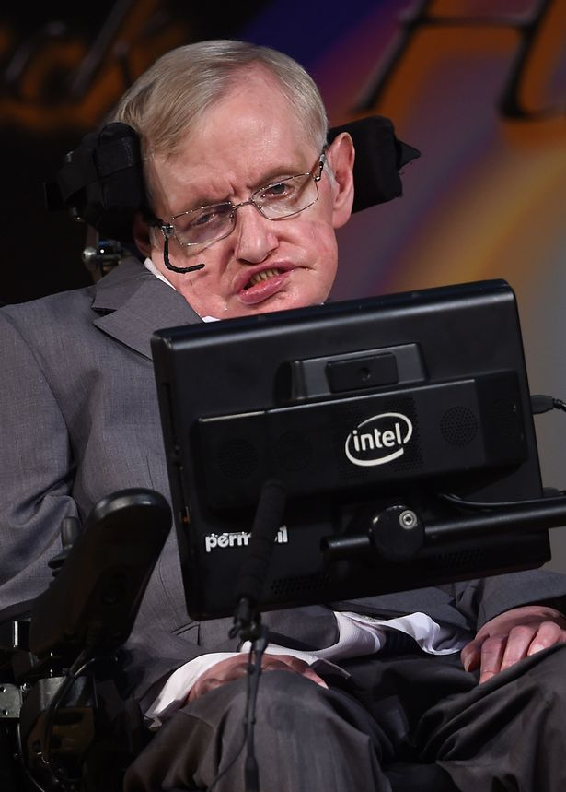

Slide 37
Adapting to Other Business Cultures
(LO 4) List four general guidelines for adapting to any business culture.

Slide 38
Behaviors to avoid:
Ethnocentrism & Stereotyping
Ethnocentrism
  Tendency to judge all other groups according to the standards, behaviors, and customs of one’s own group
Notes:
Ethnocentrism is the tendency to judge other groups according to the standards, behaviors, and customs of one’s own group. Given the automatic influence of one’s own culture, when people compare their culture to others, they often conclude that their own is superior.
Distorted views of other cultures or groups also result from stereotyping – assigning a wide range of generalized attributes to an individual on the basis of membership in a particular culture or social group. For instance, assuming that an older colleague will be out of touch with the youth market or that a younger colleague can’t be an inspiring leader would be stereotyping age groups.

Slide 39
Stereotyping
  Assigning generalized attributes to an individual on the basis of membership in a particular group

Slide 40
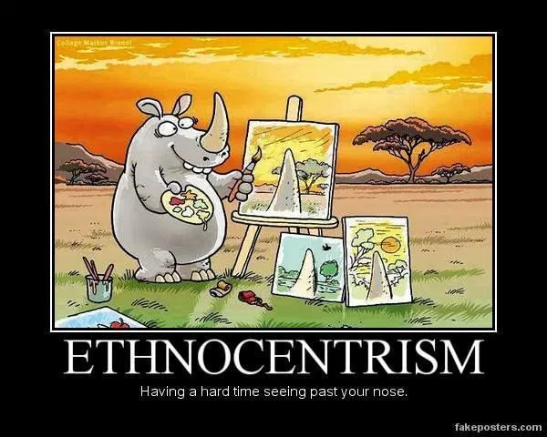
Ethnocentrism

Slide 41


Slide 42

Stereotypes

Slide 43
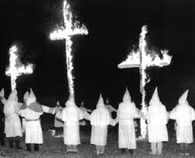
Xenophobia

Slide 44

Xenophobia

Slide 45
dislike of or prejudice against people from other countries.
"the resurgence of racism and xenophobia

Slide 46

Xenophobic attacks in South Africa

Slide 47
Guidelines for Adapting to Any Business Culture
Be Aware of Your Own Biases
Use Caution Applying the “Golden Rule”
Practice Tolerance, Flexibility, and Respect
Practice Patience and Maintain a Sense of Humor
Notes:
Here are four guidelines for adapting to any business culture:
Become aware of your own biases.
Successful intercultural communication requires more than just an understanding of the other party’s culture; you need to understand your own culture and the way it shapes your communication habits. For instance, knowing that you value independence and individual accomplishment will help you communicate more successfully in a culture that values consensus and group harmony.
Be careful about applying the “Golden Rule.”
You probably heard this growing up: “Treat people the way you want to be treated.” The problem with the Golden Rule is that other people don’t always want to be treated the same way you want to be treated, particularly across cultural boundaries. The best approach: Treat people the way they want to be treated.
Exercise tolerance, flexibility, and respect.
As IBM’s Ron Glover puts it, “To the greatest extent possible, we try to manage our people and our practices in ways that are respectful of the core principles of any given country or organization or culture.”
Practice patience and maintain a sense of humor.
Even the most committed and attuned business professionals can make mistakes in intercultural communication, so it is vital for all parties to be patient with one another. As business becomes ever more global, even people in the most tradition-bound cultures are learning to deal with outsiders more patiently and overlook occasional cultural blunders. A sense of humor is a helpful asset as well, allowing people to move past awkward and embarrassing moments. When you make a mistake, simply apologize and, if appropriate, ask the other person to explain the accepted way; then move on.

Slide 48
Be Aware of Your Own Biases
you need to understand your own culture and the way it shapes your communication habits. For instance, knowing that you value independence and individual accomplishment will help you communicate more successfully in a culture that values consensus and group harmony.

Slide 49
Use Caution Applying the “Golden Rule”
“Treat people the way you want to be treated.” or,
Treat people the way they want to be treated.

Slide 50
Practice Patience and Maintain a Sense of Humor
Even the most committed and attuned business professionals can make mistakes in intercultural communication, so it is vital for all parties to be patient with one another.

Slide 51
Guidelines for Adapting to U.S. Business Culture
Individualism
Equality
Privacy and Personal Space
Time and Schedules
Religion
Communication Style
Notes:
If you are a recent immigrant to the United States or grew up in a culture outside the U.S. mainstream, you can apply all the concepts and skills in this chapter to help adapt to U.S. business culture. Here are some key points to remember as you become accustomed to business communication in this country:
Individualism. In contrast to cultures that value group harmony and group success, U.S. culture generally expects individuals to succeed by their own efforts, and it rewards individual success. Even though teamwork is emphasized in many companies, competition between individuals is expected and even encouraged in many cases.
Equality. Although the country’s historical record on equality has not always been positive and inequalities still exist, equality is considered a core American value. This principle applies to race, gender, social background, and even age. To a greater degree than people in many other cultures, Americans believe that every person should be given the opportunity to pursue whatever dreams and goals he or she has in life.
Privacy and personal space. Although this appears to be changing somewhat with the popularity of social networking and other personal media, people in the United States are accustomed to a fair amount of privacy. That also applies to their “personal space” at work. For example, they expect you to knock before entering a closed office and to avoid asking questions about personal beliefs or activities until they get to know you well.
Time and schedules. U.S. businesses value punctuality and the efficient use of time. For instance, meetings are expected to start and end at designated times.
Religion. The United States does not have an official national religion. Many religions are practiced throughout the country, and people are expected to respect each other’s beliefs.
Communication style. Communication tends to be direct and focused more on content and transactions than on relationships or group harmony.

Slide 52
Improving Intercultural Communication Skills
(LO 5) Identify seven steps you can take to improve your intercultural communication skills.

Slide 53
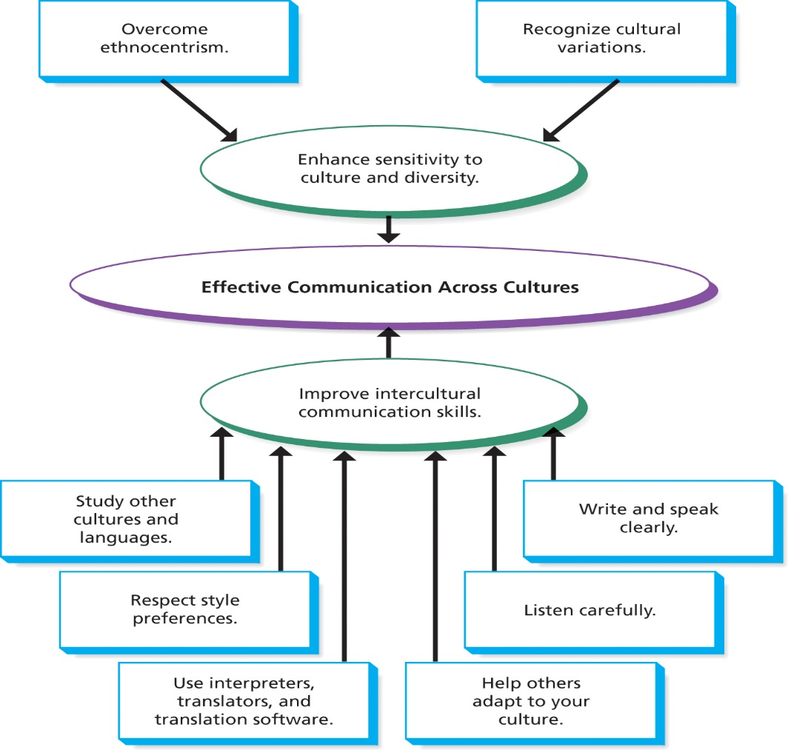
Components of Successful Intercultural Communication
Notes:
Figure 3.2 Components of Successful Intercultural Communication
Communicating in a diverse business environment is not always an easy task, but you can continue to improve your sensitivity and build your skills as you progress in your career.
7 Steps to Improving Intercultural Communication Skills:
Study other cultures.
Study other languages.
Respect preferences for communication style.
Write clearly.
Speak and listen carefully.
Use interpreters, translators, and related software.
Help others adapt to your culture.

Slide 54
Writing for Multilingual Audiences (1 of 3)
Use Plain Language
Use Precise Words
Use Clear Examples
Cite Numbers Carefully
Avoid Slang & Jargon
Be Brief
Use Short Paragraphs
Use Transitions
Notes:
Ideally, businesses can communicate with employees, customers, and other stakeholders in their native languages. However, translation isn’t always cost effective or possible. To write effectively for people who may not be comfortable using your language, remember these tips:
Use plain language. Use short, precise words that say exactly what you mean.
Avoid words with multiple meanings. As much as possible, choose words that have only one obvious meaning in the context you’re using them.
Be clear. Rely on specific terms and concrete examples to explain your points.
Cite numbers carefully. Use figures (such as “27”) instead of spelling them out (“twenty-seven”).
Avoid slang and be careful with technical jargon and abbreviations. Slang and other nonstandard usages can be difficult or impossible for your audience to translate.
Be brief. Construct sentences that are short and simple.
Use short paragraphs. Each paragraph should stick to one topic.
Use transitions generously. Help readers follow your train of thought.

Slide 55
Use Plain Language
Use short, precise words that say exactly what you mean.

Slide 56
Avoid words with multiple meanings
I will give you a ring when I arrive in Chinghai

Slide 57
Use precise words

Slide 58
Cite numbers carefully
Use figures instead of spelling them out.
We will give you a 15% discount.

Slide 59
Avoid Slang
consisting of words and phrases that are regarded as
very informal, are more common in speech than
writing, and are typically restricted to a particular
context or group of people.

Slide 60

Examples of slang

Slide 61
Slang
We aint going no where
This is way cool.
The day was a bummer
Have some face time

Slide 62
Avoid jargon
special words or expressions used by a profession or group that are difficult for others to understand

Slide 63
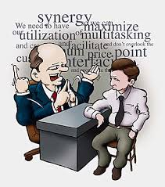

Slide 64
Jargon
Malware, Trojans Vs. Viruses

Slide 65
Avoid Abbreviations
a shortened form of a word or phrase
PD
FYI
LOL
TTYL

Slide 66
Avoid Idioms
a group of words established by usage as
having a meaning not deducible from those
of the individual words

Slide 67


Slide 68


Slide 69


Slide 70
Sports idioms
Slam-dunk
Touch down
Home run
Knock-down

Slide 71
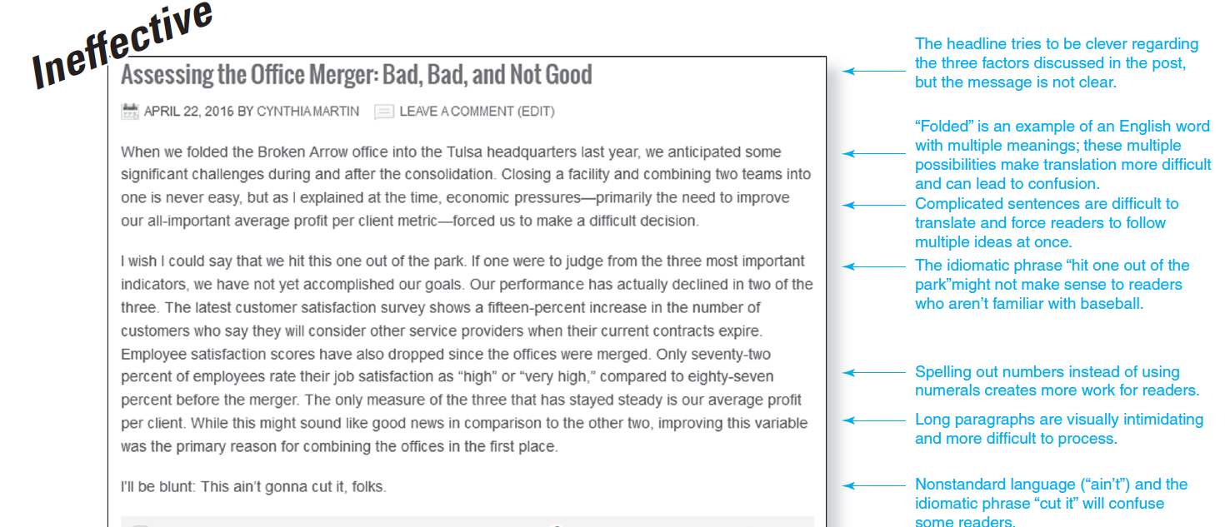
Writing for Multilingual Audiences (2 of 3)

Slide 72
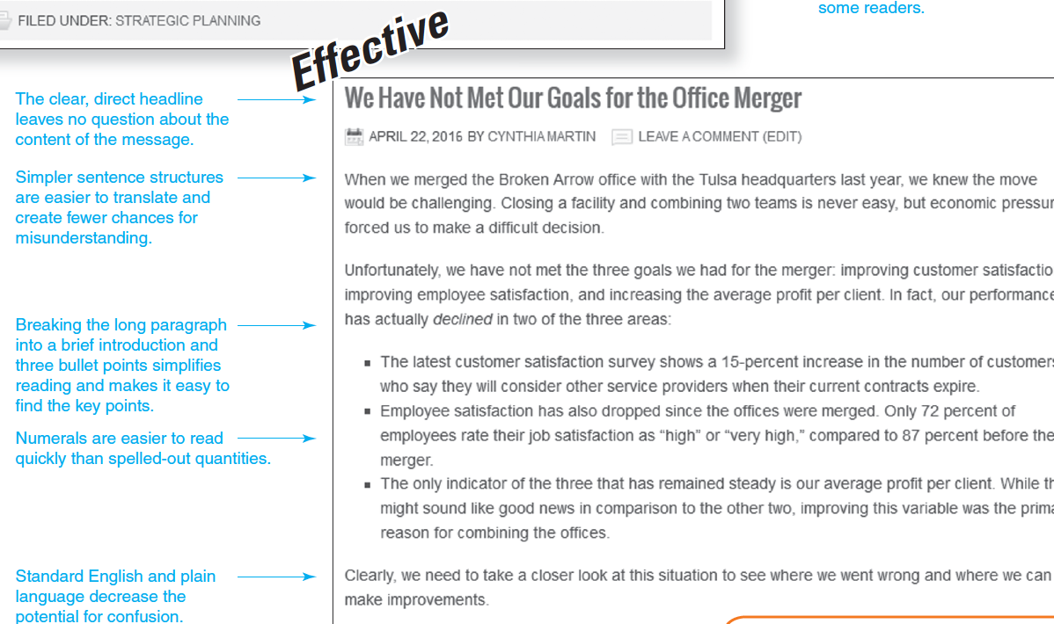
Writing for Multilingual Audiences (3 of 3)

Slide 73
Speaking with Multilingual Audiences (1 of 2)
Speak clearly and simply.
Look for feedback.
Rephrase as needed.
Clarify your meaning with examples.
Don’t “talk down” to other person.
Notes:
When speaking in English to people whose native language is not English, you may find these tips helpful:
Speak clearly, simply, and relatively slowly. Pronounce words clearly, stop at distinct punctuation points, and make one point at a time.
Look for feedback. Be alert to signs of confusion in your listener. Realize that nods and smiles do not necessarily mean understanding.
Rephrase if necessary. If someone does not seem to understand you, rephrase using simpler words.
Clarify your meaning with repetition and examples. Use concrete and specific examples to illustrate difficult or vague ideas.
Do not talk down to the other person. Try not to over-enunciate and do not “blame” the listener for not understanding. Say, “Am I going too fast?” rather than “Is this too difficult for you?”

Slide 74
Speaking with Multilingual Audiences (2 of 2)
Learn common greetings and key phrases.
Listen with care and respect.
Adapt your style to the other person.
Check for comprehension often.
Clarify what will happen next.
Notes:
Learn important phrases in your audience’s language. Learn common greetings and a few simple phrases in the other person’s native language; this not only makes initial contact easier, but it also shows respect.
Listen carefully and respectfully. If you don’t understand a comment, ask the person to repeat it.
Adapt your conversation style to the other person’s style. For instance, if the other person appears to be direct and straightforward, follow suit.
Check frequently for comprehension. After you make each point, pause to gauge the other person’s comprehension before moving on.
Clarify what will happen next. At the end of a conversation, be sure that you and the other person agree on what has been said and decided.
Finally, remember that oral communication can be more difficult for audiences because it happens in real time and in the presence of other people. In some situations, written communication will be more successful because it gives a reader the opportunity to translate in private and at his or her own pace.

Slide 75

Any Question?

